Slide 1
Diabetes Prediction
Y
YueFeng Xue & Irina Lee

Slide 2
Motivation
I
How can machine learning be used to help predict whether people have diabetes or prediabetes?
Symptoms being mild and developing over time
Take Years to diagnostic
#8 Ranked Cause of Death
Notes:
The focus of our question is How can machine learning be used to help predict whether people have diabetes or prediabetes?
Understanding and predicting diabetes and prediabetes through machine learning holds significant potential in the medical field, primarily due to the often mild and gradual onset of symptoms. These conditions can develop silently over many years, making timely diagnosis challenging. By leveraging machine learning, we can analyze vast amounts of health data to identify patterns and risk factors that may not be immediately apparent through traditional methods. Early detection is crucial, as diabetes is currently the eighth leading cause of death globally. Machine learning models can provide a proactive approach, enabling earlier interventions that can significantly improve patient outcomes and reduce the long-term health impacts of diabetes. This research aims to harness the power of machine learning to enhance diagnostic accuracy and speed, ultimately saving lives and improving the quality of life for millions of individuals.

Slide 3
Research Conducted in this Area
Y
Promising Results in Diabetes Prediction Using Machine Learning
Increasing Interests in Predicting Using Non-Invasive Data
Looking for Other Cost & Time Efficient Approach
Notes:
For research that has already been conducted in the industry, there has been showing promising results in diabetes prediction using machine learning. And in recent years there has been increasing interests in predicting diabetes using less invasive data because it usually takes a really long time to gather invasive data through labs for patients. And because of this, the industry is also looking for other cost efficient and time efficient approach for diabetes research. As medical tests can be intimidating and costly. This offers a cheap pre-screening solution for people looking to take the first step in bettering their health.

Slide 4
Our Plan
I
A diabetes dataset with less-invasive features
EDA & Data Cleaning
Feature Selection
Select Model & Build Baseline
Model Advancement & Hyperparameter Tuning
Evaluation & Conclusion
Notes:
Our study demonstrates an accuracy rate of 80% in predicting diabetes and pre-diabetes, highlighting the potential of machine learning in early detection. However, it's important to note that this is a preliminary test intended for pre-screening purposes only and is not designed to replace official medical tests. For a more accurate and comprehensive diagnosis, we strongly recommend consulting a licensed medical professional who can conduct detailed diabetes testing.
This proactive approach offers significant benefits. By identifying individuals at risk early, we can facilitate timely interventions, potentially preventing the progression to full-blown diabetes. Early detection can lead to better management of the condition, improved patient outcomes, and a reduction in the long-term health complications associated with diabetes. Furthermore, it can alleviate the burden on healthcare systems by reducing the incidence of severe diabetes-related health issues. This research aims to empower individuals with early knowledge of their health status, promoting proactive health management and ultimately improving quality of life.
In this diagram we see a flow chart of a high level overview of our process. We start with a dataset with less-invasive features, perform any EDA and data cleaning, select the most relevant features, build a baseline model, then we add on to the baseline model with a more advanced model and perform hyperparameter tuning. After that we will evaluate our findings and what we can conclude from them.

Slide 5
Data
Y
Category | Description
Method of Data Collection | Health-related telephone survey that is collected annually by the CDC in 2015
Number of Features | 22
Outcome Feature | Diabetes_binary (0: no diabetes; 1: prediabetes or diabetes)
Outcome Feature Balance | Yes, 50/50 Split
Missing Values | 0
Total Rows | 70692
Duplicated Rows | 1635
Notes:
The data we are using is a 50/50 split balanced dataset from 2015. Since this data collected is in forms of survey, it means that all its features are less invasive. After doing some initial data exploration, we found that…

Slide 6
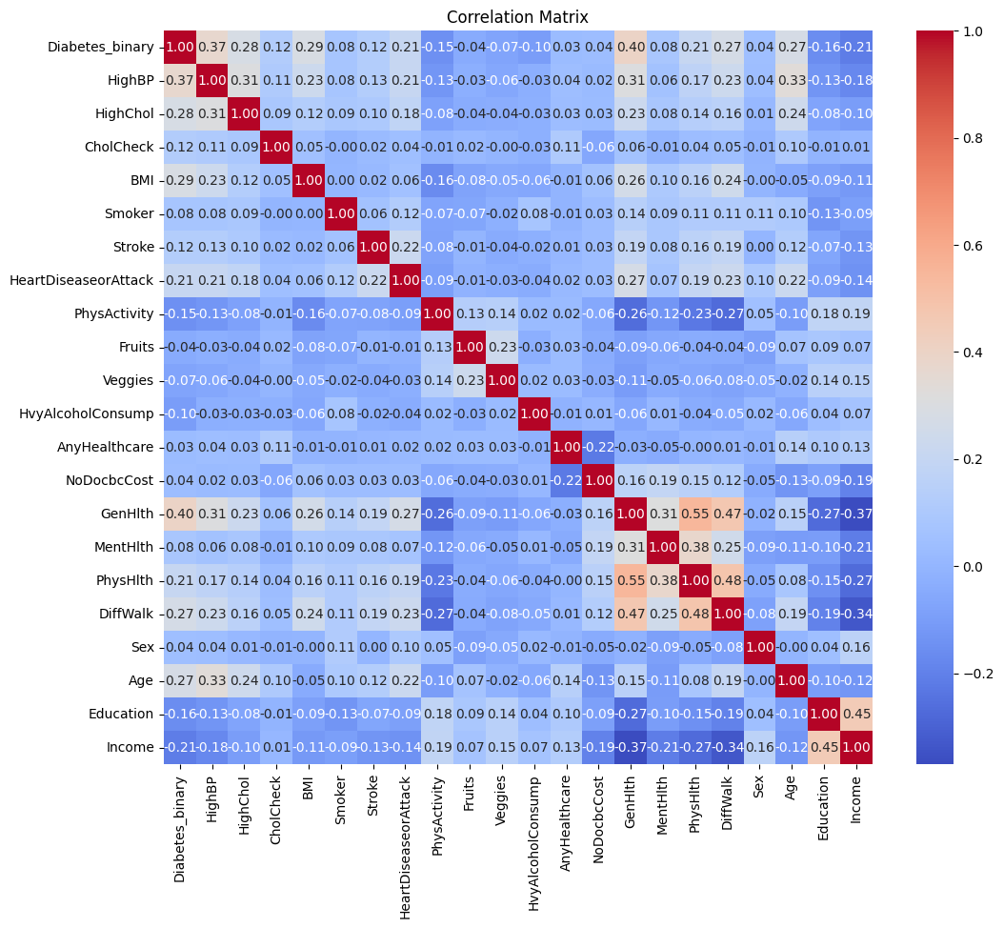
Correlation Matrix
Y
Notes:
From our correlation matrix, we can see all 21 features have some correlation to our outcome variable diabetes binary. To improve model performance, we decided to choose features that have relatively higher correlation to be used in our training. In this case we will be choosing.. Since the outcome variable is binary (0 and 1), we will be using binary classification for this analysis.

Slide 7
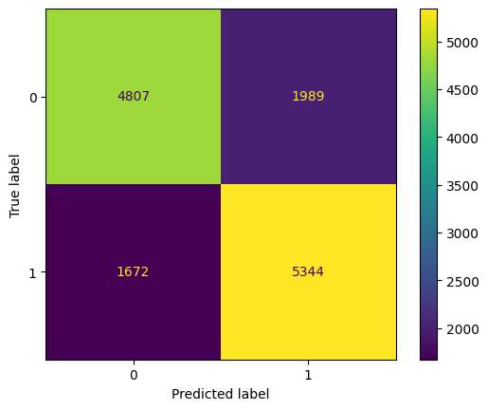
Baseline Model:
Logistic Regression
Y
Training Accuracy: 0.7401
Validation Accuracy: 0.7479
Testing Accuracy: 0.7349
Test Set - Diabetic & Pre-Diabetic Accuracy: 0.7617
Test Set - Non-Diabetic Accuracy: 0.7073
Notes:
For our baseline model, we implemented a simple logistic regression model and we have our baseline training accuracy …. And our goal is to improve the Diabetic & Pre-Diabetic Accuracy
Why a Baseline model?
First, to Benchmark Performance: A baseline model establishes a reference point for evaluating the performance of more complex models. By comparing advanced models to this baseline, you can objectively measure improvements and ensure that the added complexity is justified by a significant performance gain.
Secondly, for its Simplicity and Interpretability: Logistic regression is straightforward and highly interpretable. Understanding the behavior and coefficients of a logistic regression model can provide insights into the underlying data patterns, which can inform the design and tuning of more complex models.

Slide 8
Improved Model
Neural Network
I
Input Layer
Hidden Layer
1
Batch
Norm
Dropout Layer
Hidden Layer
2
Batch
Norm
Dropout Layer
Output Layer
(Sigmoid)
Notes:
Our improved model utilizes a neural network. The architecture begins with the input layer, which is designed to receive the features from our dataset. This layer serves as the starting point for processing our input data.
Following the input layer, we have the first hidden layer, labeled as Hidden Layer 1. This layer consists of neurons that apply a transformation to the input data, capturing complex patterns and relationships. The activation function used here is ReLU, which introduces non-linearity and helps the network learn from the data.
Next, we incorporate Batch Normalization, which normalizes the inputs of each mini-batch. This step helps in stabilizing and accelerating the training process by reducing the internal covariate shift.
After Batch Normalization, we have a Dropout layer. Dropout is a regularization technique that randomly sets a fraction of the input units to zero at each update during training. This helps prevent overfitting by ensuring that the network does not rely too heavily on any single neuron.
Following the Dropout layer, we have the second hidden layer, labeled as Hidden Layer 2. Similar to the first hidden layer, it applies a transformation to the data, further capturing intricate patterns. Again, we use the ReLU activation function to introduce non-linearity.
We then have another Batch Normalization layer, which, like the previous one, normalizes the inputs of each mini-batch to maintain stable and efficient training.
Another Dropout layer follows, providing additional regularization to help mitigate overfitting.
Finally, we reach the output layer. This layer is a single neuron with a sigmoid activation function, which outputs a value between 0 and 1. This is particularly suitable for our binary classification task of predicting diabetes or pre-diabetes, as it represents the probability of the positive class.
In the next few slides, we present the results of our comprehensive experiments, focusing on optimizing our neural network model's performance by varying different hyperparameters

Slide 9
Experiment
Learning Rate: 0.001; Batch Size: 64; Epoch: 200
I
Index | Hidden Size | Activation | Optimizer | Dropout Rate | Parameters | Training Accuracy | Validation Accuracy
1 | [64, 32] | relu | SGD | [0.5, 0.3] | 3139 | 0.7402 | 0.7508
2 | [64, 32] | relu | Adam | [0.5, 0.3] | 9029 | 0.7438 | 0.7503
3 | [64, 32] | tanh | SGD | [0.5, 0.3] | 3139 | 0.7405 | 0.7500
4 | [64, 32] | tanh | Adam | [0.5, 0.3] | 9029 | 0.7426 | 0.7503
5 | [128, 64] | relu | SGD | [0.5, 0.3] | 10371 | 0.7420 | 0.7501
6 | [128, 64] | relu | Adam | [0.5, 0.3] | 30341 | 0.7447 | 0.7514
7 | [128, 64] | tanh | SGD | [0.5, 0.3] | 10371 | 0.7407 | 0.7495
8 | [128, 64] | tanh | Adam | [0.5, 0.3] | 30341 | 0.7444 | 0.7506
Notes:
In the first table, we explored various combinations of hidden layer sizes, activation functions, optimizers, and dropout rates. We fixed the learning rate at 0.001, batch size at 64, and trained for 200 epochs.
Hidden Layer Sizes: We tested two configurations: [64, 32] and [128, 64].
Activation Functions: We used both relu and tanh.
Optimizers: We experimented with SGD and Adam.
Dropout Rates: The dropout rates varied between [0.5, 0.3].
The highlighted experiment (Index 6) with hidden sizes [128, 64], relu activation, Adam optimizer, and dropout rates of [0.5, 0.3] yielded a training accuracy of 0.7447 and a validation accuracy of 0.7514, indicating one of the best performances.

Slide 10
Experiment
Learning Rate: 0.001; Batch Size: 64; Epoch: 200
I
Index | Hidden Size | Activation | Optimizer | Dropout Rate | Parameters | Training Accuracy | Validation Accuracy
9 | [128, 64] | relu | Adam | [0.3, 0.3] | 30341 | 0.7443 | 0.7506
10 | [128, 64] | relu | Adam | [0.4, 0.4] | 30341 | 0.7450 | 0.7516
11 | [128, 64] | relu | Adam | [0.5, 0.5] | 30341 | 0.7447 | 0.7511
12 | [128, 64] | relu | Adam | [0.4, 0.3] | 30341 | 0.7456 | 0.7517
13 | [128, 64] | relu | Adam | [0.3, 0.4] | 30341 | 0.7446 | 0.7524
6 | [128, 64] | relu | Adam | [0.5, 0.3] | 30341 | 0.7442 | 0.7514
14 | [128, 64] | relu | Adam | [0.3, 0.5] | 30341 | 0.7449 | 0.7514
15 | [128, 64] | relu | Adam | [0.4, 0.5] | 30341 | 0.7449 | 0.7520
16 | [128, 64] | relu | Adam | [0.5, 0.4] | 30341 | 0.7447 | 0.7521
Notes:
In the second table, we continued our experiments with hidden sizes [128, 64] while varying the dropout rates more extensively. All configurations used the relu activation function and the Adam optimizer, consistent with the promising results from the previous experiments.
Here, we observed that different dropout rate combinations had a significant impact on the model's performance. The experiment at Index 13, with dropout rates [0.3, 0.4], achieved a validation accuracy of 0.7524, which was an improvement over the previous best.

Slide 11
Experiment
Hidden Size: [128, 64]; Activation: relu; Optimizer: Adam; Dropout: [0.3, 0.4]
I
Index | Batch Size | Learning Rate | Epoch | Parameters | Training Accuracy | Validation Accuracy
17 | 128 | 0.001 | 200 | 30341 | 0.7442 | 0.7501
13 | 64 | 0.001 | 200 | 30341 | 0.7446 | 0.7524
18 | 32 | 0.001 | 200 | 30341 | 0.7447 | 0.7505
19 | 128 | 0.0001 | 200 | 30341 | 0.7467 | 0.7508
20 | 64 | 0.0001 | 200 | 30341 | 0.7450 | 0.7507
21 | 32 | 0.0001 | 200 | 30341 | 0.7458 | 0.7500
22 | 128 | 0.01 | 200 | 30341 | 0.7438 | 0.7530
23 | 64 | 0.01 | 200 | 30341 | 0.7436 | 0.7500
24 | 32 | 0.01 | 200 | 30341 | 0.7435 | 0.7501
Notes:
In the third table, we focused on optimizing the batch size and learning rate while fixing other parameters to their best-performing values from previous experiments (hidden sizes [128, 64], relu activation, Adam optimizer, and dropout rates [0.3, 0.4]).
Batch Sizes: We tested batch sizes of 32, 64, and 128.
Learning Rates: We experimented with learning rates of 0.001 and 0.01.
The results showed that increasing the batch size to 128 and using a learning rate of 0.01 (as highlighted in Index 22) achieved the highest validation accuracy of 0.7530, indicating that this configuration provided the best performance for our model.
In all, the most successful configuration featured hidden layer sizes [128, 64], relu activation, Adam optimizer, dropout rates of [0.3, 0.4], a batch size of 128, and a learning rate of 0.01.
Hidden Layer Sizes [128, 64]: This configuration means that our neural network has two hidden layers. The first hidden layer has 128 neurons, and the second hidden layer has 64 neurons. The layers are responsible for capturing and learning the complex patterns in the data.
relu Activation: The RELU activation function is used in the hidden layers. ReLU introduces non-linearity into the model, allowing it to learn more complex functions. It helps to address the vanishing gradient problem and generally speeds up the convergence of the model during training.
Adam Optimizer: Adam is an optimization algorithm that adjusts the learning rate for each parameter.
Dropout Rates of [0.3, 0.4]: Dropout is a regularization technique used to prevent overfitting. In our configuration, we apply a dropout rate of 0.3 to the first hidden layer and 0.4 to the second hidden layer. This means that 30% of the neurons in the first hidden layer and 40% of the neurons in the second hidden layer are randomly dropped out during training, promoting the robustness of the model.
Batch Size of 128: Batch size refers to the number of training examples utilized in one iteration. A batch size of 128 means that the model updates its weights after processing 128 samples. Larger batch sizes generally lead to more stable and efficient training processes, as they provide more accurate estimates of the gradient.
Learning Rate of 0.01: The learning rate controls how much to change the model in response to the estimated error each time the model weights are updated. A learning rate of 0.01 used means that the weights are adjusted with a step size of 0.01 during each update. This value was found to be optimal for our model, balancing between fast convergence and stable training.

Slide 12
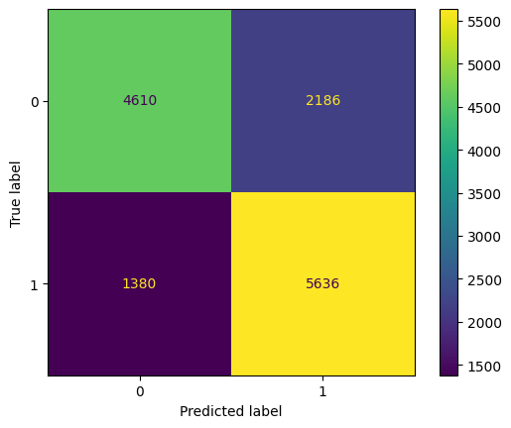
Conclusion - Result
I
Training Accuracy: 0.7438
Validation Accuracy: 0.7530
Testing Accuracy: 0.7418
Test Set - Diabetic & Pre-Diabetic Accuracy: 0.8033
Test Set - Non-Diabetic Accuracy: 0.6783
Notes:
In this slide, we present the confusion matrix and accuracy metrics for our neural network model, highlighting its performance on different sets of data.
Confusion Matrix: The confusion matrix on the left visualizes the model's predictions:
The top-left cell (4610) represents the true negatives, where the model correctly predicted non-diabetic cases.
The top-right cell (2186) shows the false positives, where the model incorrectly predicted diabetic cases for non-diabetic individuals.
The bottom-left cell (1380) represents the false negatives, where the model incorrectly predicted non-diabetic cases for diabetic individuals.
The bottom-right cell (5636) shows the true positives, where the model correctly predicted diabetic cases.
Accuracy Metrics:
Training Accuracy: 0.7438: This indicates that the model correctly classified 74.38% of the training data.
Validation Accuracy: 0.7530: This metric shows that the model correctly classified 75.30% of the validation data, indicating that the model is generalizing well to unseen data during the training phase.
Testing Accuracy: 0.418: The overall testing accuracy indicates that the model correctly classified 41.8% of the test data. This relatively lower accuracy suggests that the model's performance on the test set may need further improvement or that the test set might have different characteristics compared to the training and validation sets.
Test Set - Diabetic Accuracy: 0.8033: This metric shows that the model correctly classified 80.33% of the diabetic cases in the test set, indicating a strong performance in identifying diabetic individuals.
Test Set - Non-Diabetic Accuracy: 0.6783: This indicates that the model correctly classified 67.83% of the non-diabetic cases in the test set, which is lower than the diabetic accuracy but still demonstrates a reasonable performance in identifying non-diabetic individuals.
These metrics provide a comprehensive overview of our model's strengths and areas for improvement. The high diabetic accuracy indicates that the model is effective in identifying diabetic cases, which is crucial for early intervention and treatment. However, the lower overall test accuracy and non-diabetic accuracy suggest that further refinements are needed, possibly through additional hyperparameter tuning, more balanced training data, or advanced techniques to improve generalization. Additionally, this discrepancy may be due to difficulty with pre-diabetes as it not technically diabetes but rather in between.

Slide 13
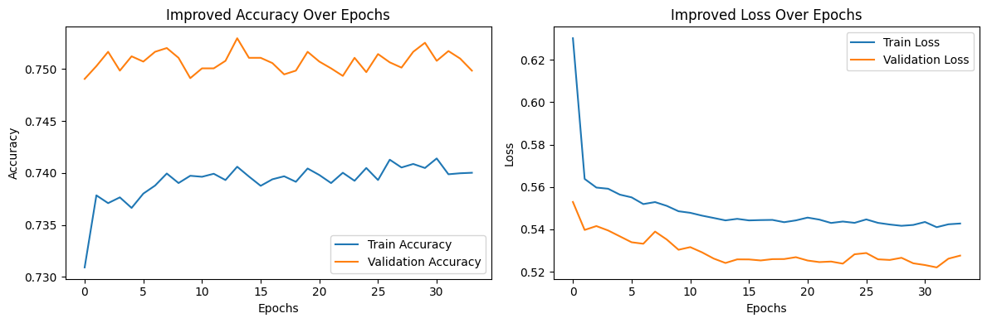
Conclusion - Result
I
Notes:
The Graph on the Left shows Improved Accuracy Over Epochs
The blue line represents the training accuracy, while the orange line represents the validation accuracy.
Initially, the training accuracy increases steadily, showing that the model is learning and improving its ability to classify the training data correctly.
The validation accuracy starts higher than the training accuracy, indicating that the model generalizes well to unseen data from the beginning.
Over the epochs, the validation accuracy fluctuates slightly but remains relatively stable around 0.75, suggesting that the model maintains its generalization capability as training progresses.
The training accuracy also stabilizes, albeit at a slightly lower value than the validation accuracy, which can be a sign that the model is not overfitting and is generalizing well.
Graph on the Right: Improved Loss Over Epochs
The blue line denotes the training loss, and the orange line indicates the validation loss.
Both the training and validation loss decrease sharply in the initial epochs, demonstrating that the model is effectively minimizing errors.
The validation loss continues to decrease and stabilizes around 0.52, which indicates that the model is learning to generalize better to unseen data.
The training loss shows a similar decreasing trend but stabilizes at a slightly higher value than the validation loss, as the model tries to balance fitting the training data while generalizing to validation data.

Slide 14
Conclusion - Avenue for Future
I
Considering more advanced model, for example: XGBoost, etc.
Exploring better hyperparameter tuning approaches, such as grid search
Looking for better datasets with potential for more feature engineering
Notes:
To further improve the performance of the neural network model, several avenues can be explored. Firstly, increasing the complexity of the model by adding more layers or increasing the number of neurons per layer could potentially capture more intricate patterns in the data. We could run more GridSearches or other methods given computational limitations. Additionally, experimenting with different activation functions, might also enhance the model's ability to learn. Additionally, optimizing hyperparameters like learning rate, batch size, and dropout rate through more extensive hyperparameter tuning methods, such as Bayesian Optimization, can fine-tune the model's performance. Incorporating advanced regularization techniques, such as L1 or L2 regularization, can help prevent overfitting and improve generalization. Moreover, leveraging ensemble methods, like combining multiple models through bagging or boosting, could yield better predictive performance. More research on exploring distinctions in pre-diabetic patients can also offer more insight to how we can better classify. Finally, exploring data augmentation techniques or integrating additional relevant features from other datasets if available might provide the model with more information to learn from, leading to better predictions.

Slide 15

Link to Github Repository
https://github.com/yuefengxue/mids-w207-final-YueFeng-Xue-Irina-Lee

Slide 16
Contribution
YueFeng Xue: Data preparation, data processing, EDA, modeling, evaluation & conclusion, design and draft PowerPoint, PowerPoint preparation, code clean-up and organize.
Irina Lee: Topic research and suggestion, data research and making a decision on what data we are using, modeling, evaluation & conclusion, code review, PowerPoint review and preparation.

Slide 17
Thank You!

